Slide 1
CSC 402: Numerical Analysis
Mathematical modelling, Trade offs, Error analysis, Fixed point, floating point.

Slide 2
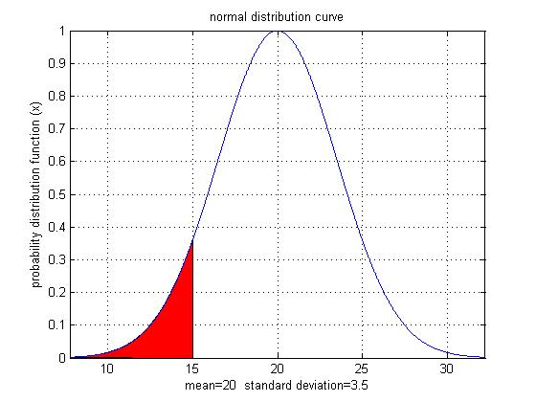
Why use Numerical Methods?
To solve problems that cannot be solved exactly
Notes:
1. The function resembles the probability density function of the standardized normal distribution such that the random variables are z-scores with solution equal to 1.
2. In statistics: The probability density function of the standardized normal distribution such that the random variables are z-scores.

Slide 3
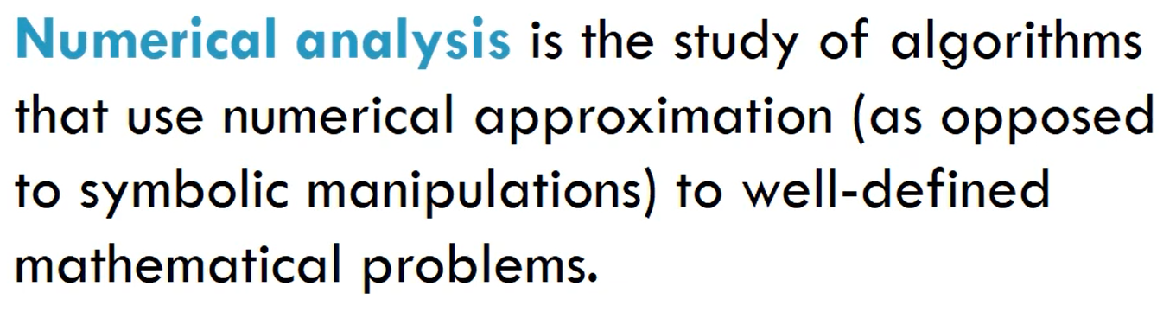
Numerical analysis is the science of finding numerical approximations to well defined mathematical problems.

Slide 4
Numerical Analysis
Numerical Analysis is a technique of mathematical analysis that uses numerical approximation in particular to obtain accurate results for some of the problems that are hard to resolve otherwise.
It is a part of engineering, architecture and scientific studies that involve applied mathematics.
Concepts like differentiation and integration, differential equations, and linear programming are also included in numerical analysis methods.

Slide 5
Numerical Analysis
Relates to the construction of numerical algorithms and methods that provide approximate solutions to an analytical problem
Numerical analysis may deal with almost all the areas of mathematical computations such as functions/data interpolation, numerical quadrature integration, differential equations approximations, finite elements and so on

Slide 6
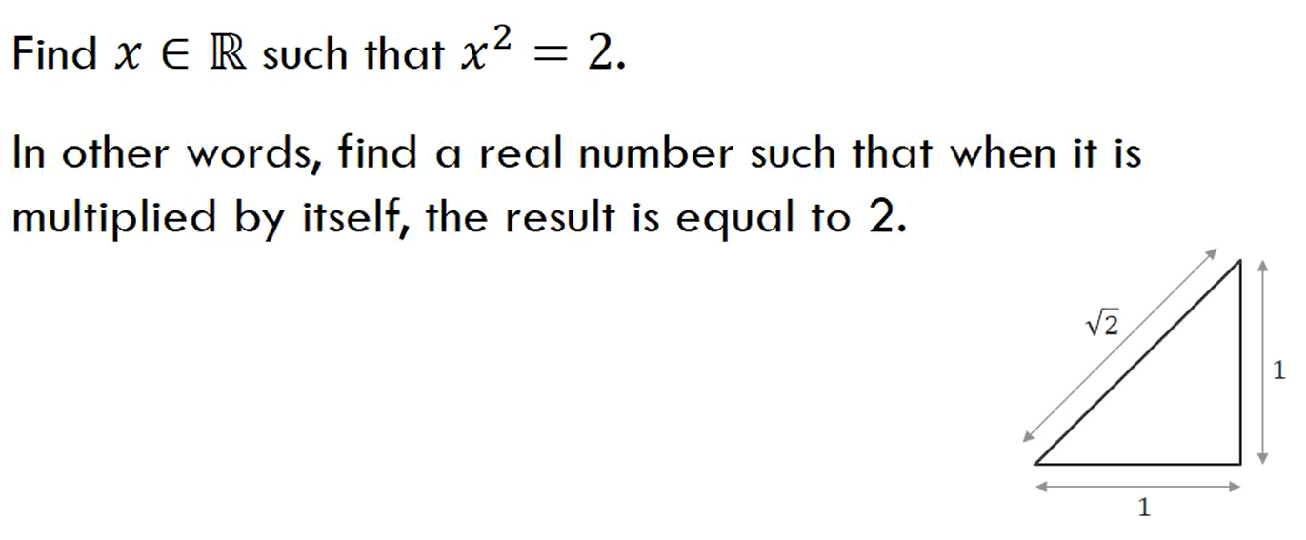

Slide 7
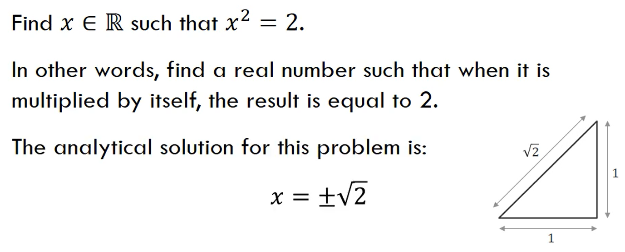

Slide 8
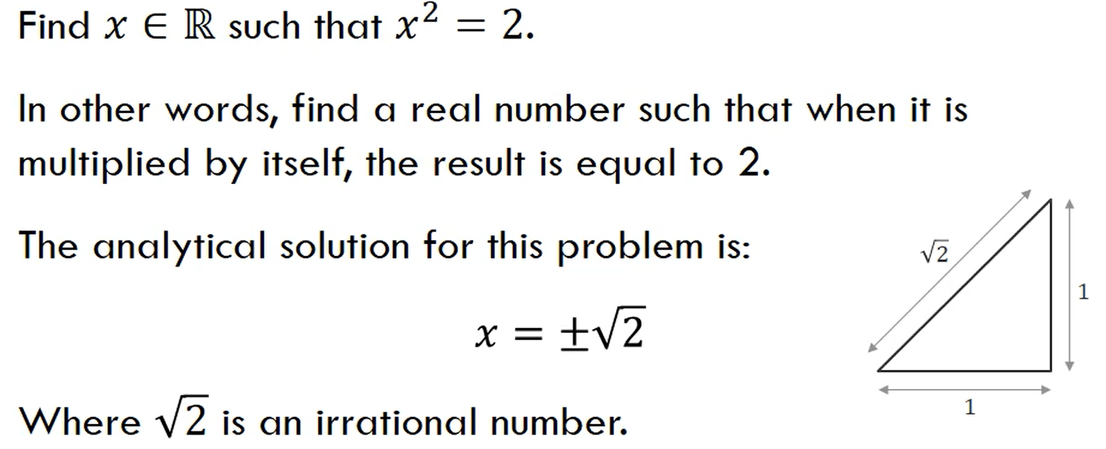

Slide 9
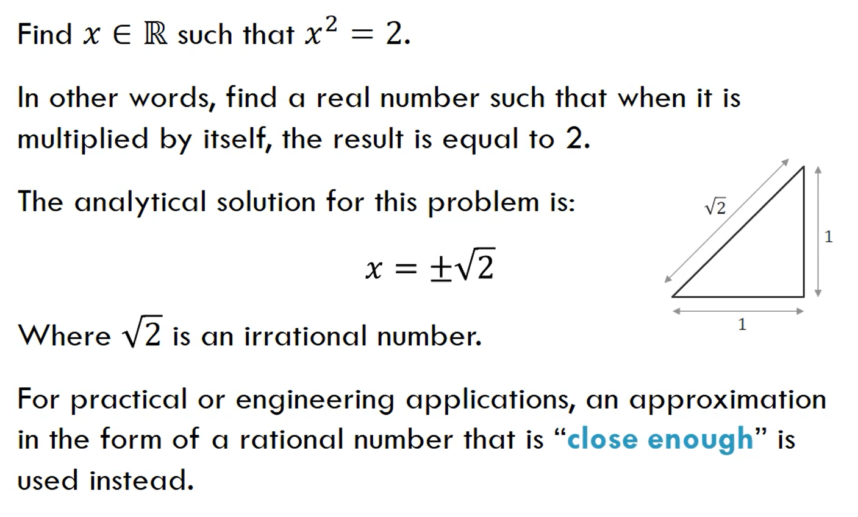
Notes:
geometrically the square root of two is equal to the length of the hypotenuse of a right triangle with the legs equal to one.
but for practical and engineering applications an approximation in the
form of a rational number that is close enough is used instead.
so how do we find what this rational number is that's close enough to the irrational number square root of well for example we can use a method called the babylonian method so the babylonian method we formulate

Slide 10
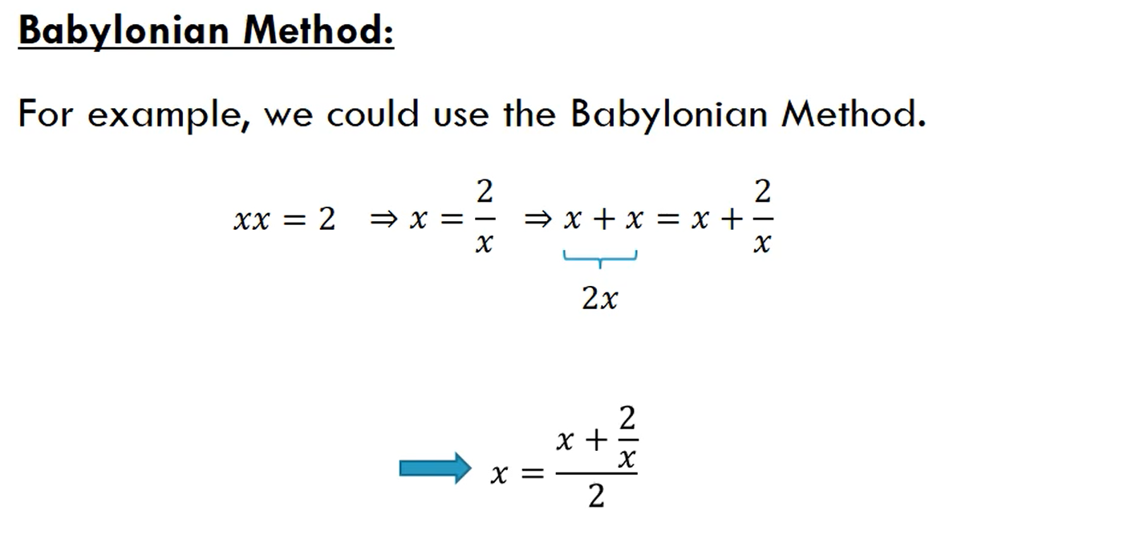
Our mathematical module

Slide 11
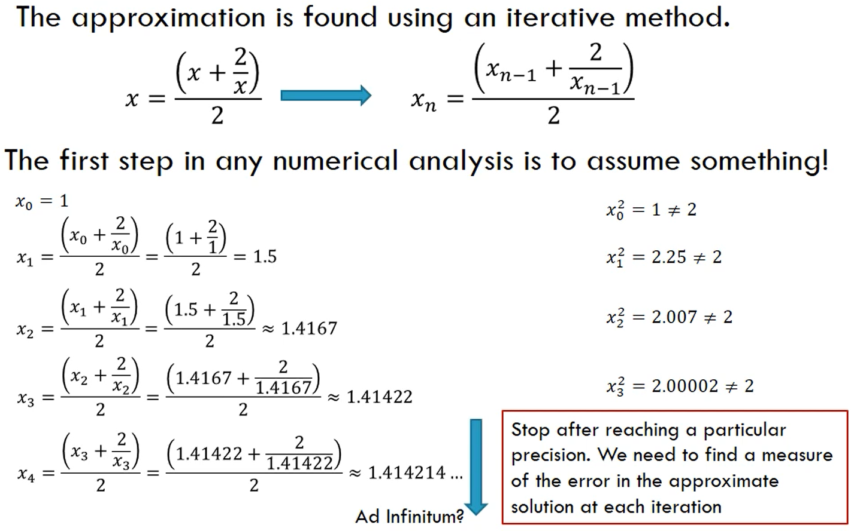

Slide 12
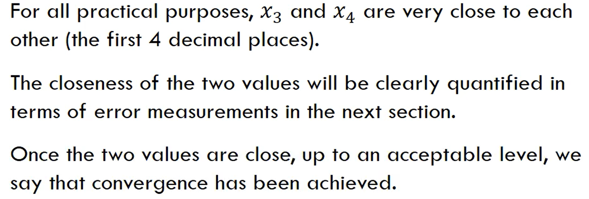

Slide 13
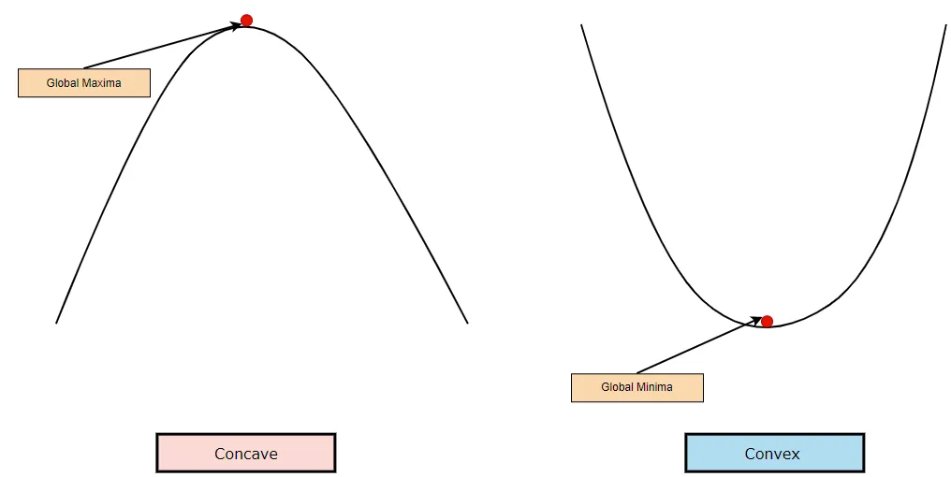

Slide 14
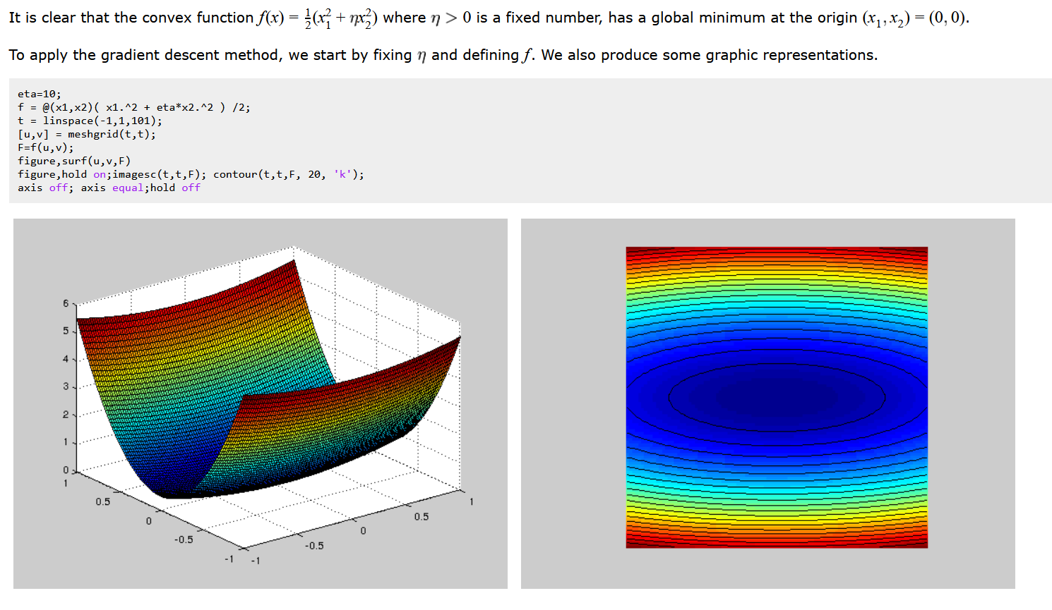
Convex function

Slide 15
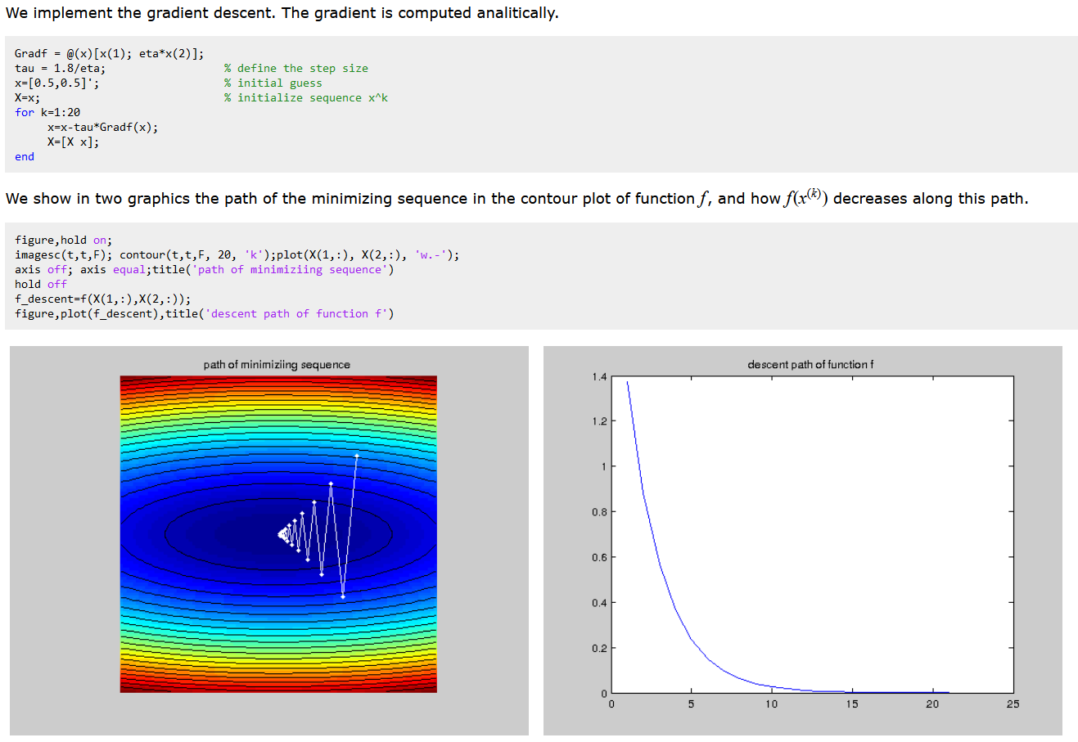

Slide 16
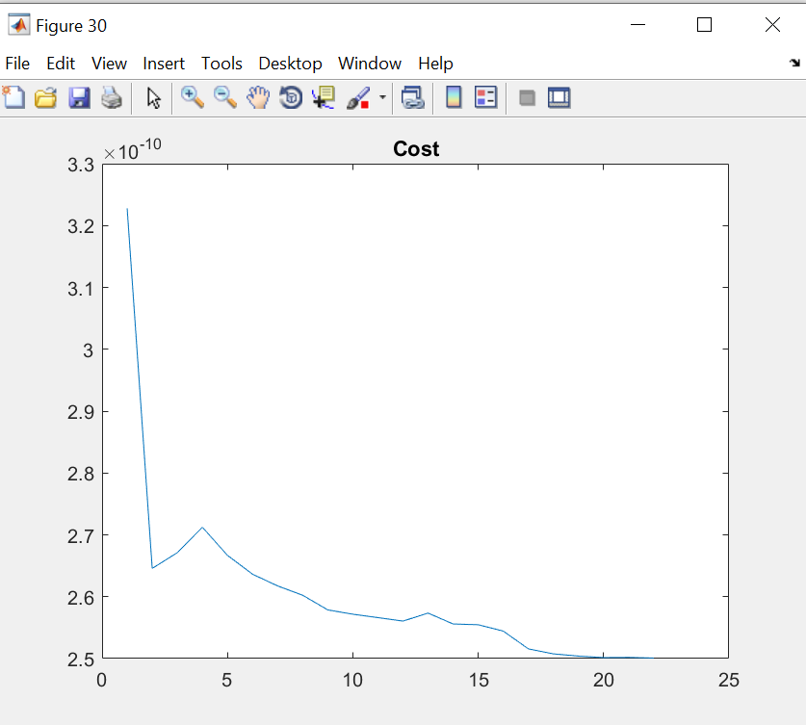

Slide 17
Where do Maths problems come from?
Mathematical modeling stems from Real world problems
Prediction time series and sales, price estimation of airline companies
Transportation: predict traffic base on location and satellite information.
Energy
Biological problems: how to perform reconstruction of degraded MRI images
Environmental: Making Weather Predictions
Car Safety Enhancement(Car crush safety simulations)
Spacecraft Dynamics (approximations on the spacecraft trajectories)

Slide 18
How do we solve an engineering problem?
Problem Description
Mathematical Model
Solution of Mathematical Model
Using the Solution

Slide 19
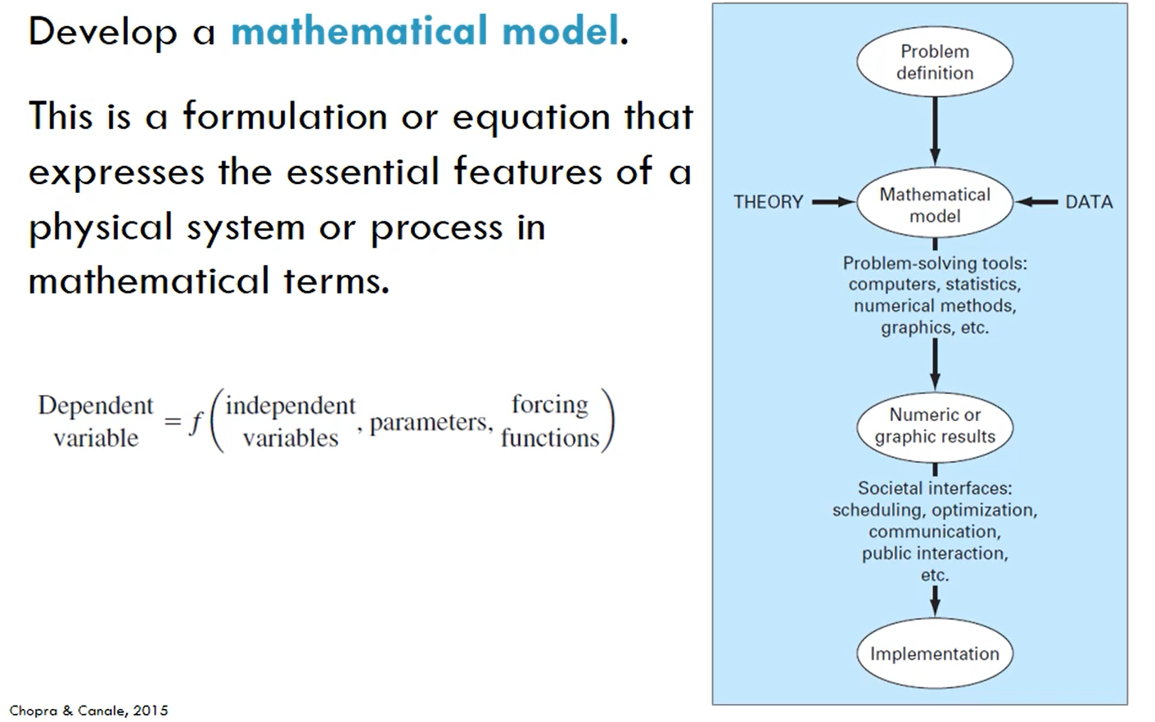

Slide 20

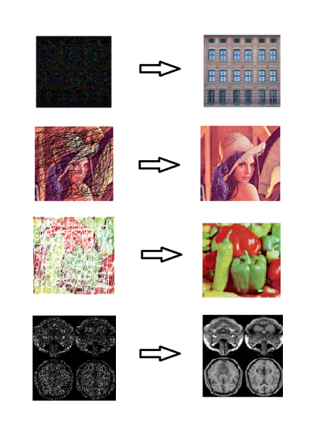
Example of computing problem
Types of Degradations
Corrupted data
Reconstructed Data
Demand
Process images so as to reduce/eliminate distortions.
Enable efficient analysis and feature extraction
Produce an image that is as close as possible to ground-truth
Areas/Industries
Medical Imaging
Smart Farming and Precision Agriculture
Plane satellite imaging
Self-driving cars
Notes:
Agriculture-computer vision, correcting images-precision agriculture(computer tech to improve agriculture),
Self driving car, anyahywhere removal of aritifact is required
Plants affected with can be isolated n treated with pesticides or taken care instead applying the pesticidesto the whole field
How artifact occur an the need to remove it.
Agriculture for improving image quality
Diagnosis of diseases in situations where equipment malfunctions or not up to standard

Slide 21
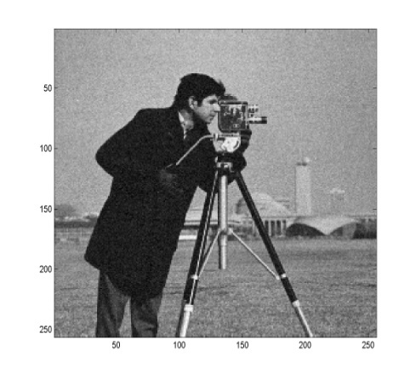

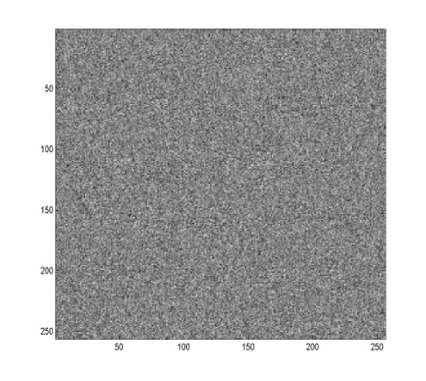
Problem statement
Y = X + N
=
+
Y: Noisy image
X: Original image
N: White Gaussian noise
Assumptions
X is unknown
X and N are uncorrelated
Noise variance may be unknown
Goal: recover X from Y

Slide 22
Noise Model
We can consider a noisy image to be modelled as follows:
where f(x, y) is the original image pixel, η(x, y) is the noise term and g(x, y) is the resulting noisy pixel
If we can estimate the model that the noise in an image is based on, this will help us to figure out how to restore the image

Slide 23
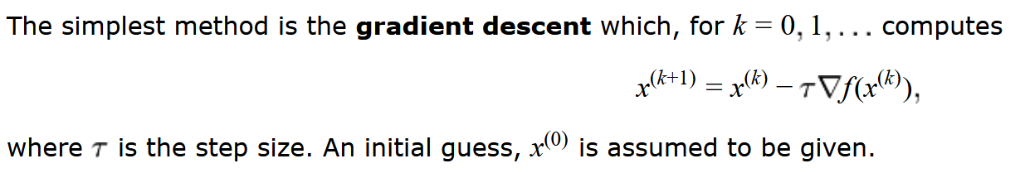
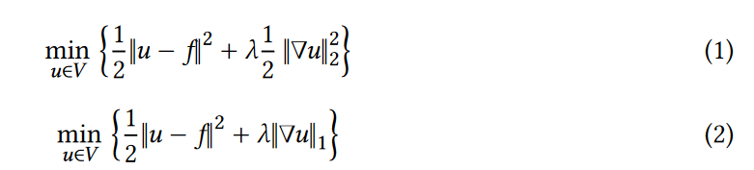
Example
Image de-noising Problem
Problem description: Perform an image enhancement on a noisy RGB image
Mathematical formulation: Y = X + N, Y = X x N (multiplicative noise)
Solution: Using gradient descent algorithm
Using the solution to produce a reconstructed image
Notes:
Show them simulations in codes.

Slide 24
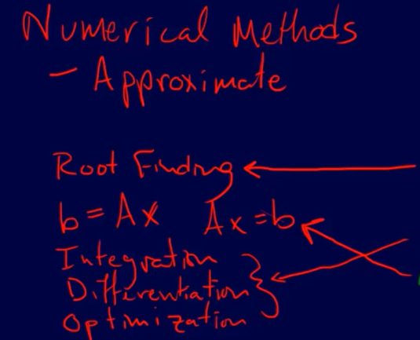
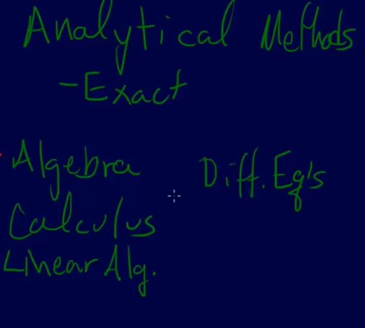
Numerical Analysis vs Numerical Linear Algebra
Notes:
We use the analytical methods in solving our numerical problems

Slide 25
Mathematical Modelling
Mathematical models leads to assumptions and approximations
Helps to solve real world problems

Slide 26
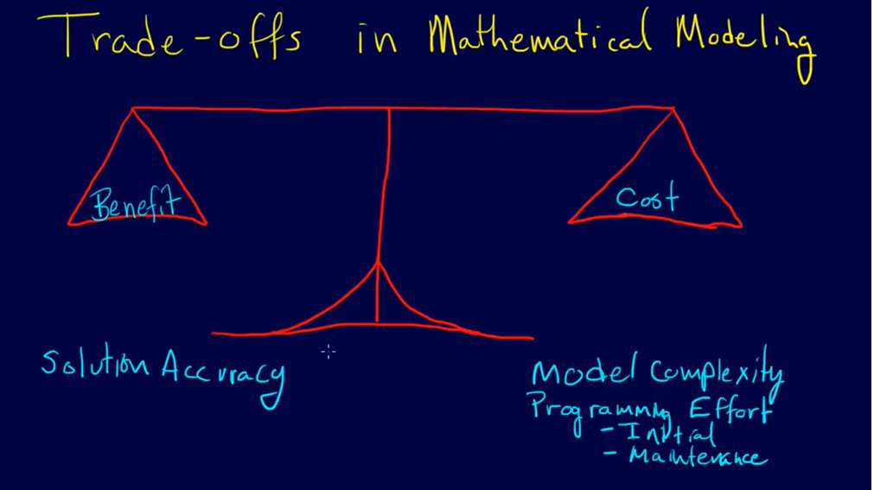
Trade offs

Slide 27
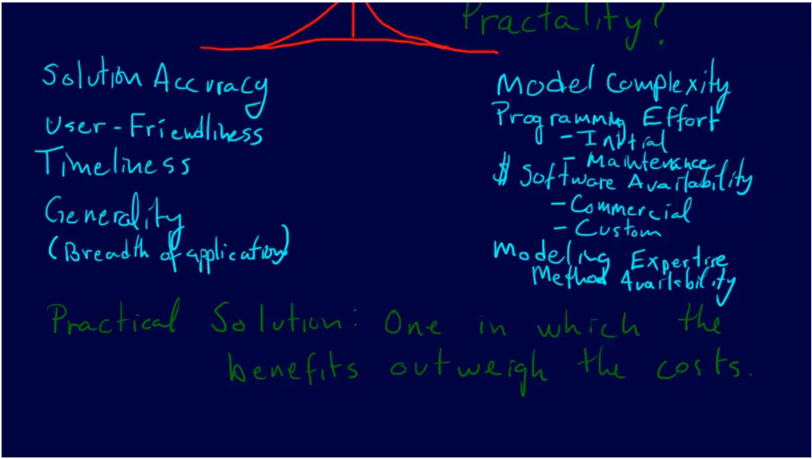
Trade offs
Notes:
Show the image processing demo

Slide 28
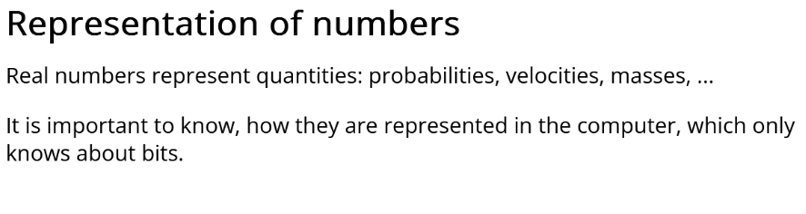
Integers
Fixed point
Floating point
Notes:
We need to talk about these before we talk about number representation

Slide 29
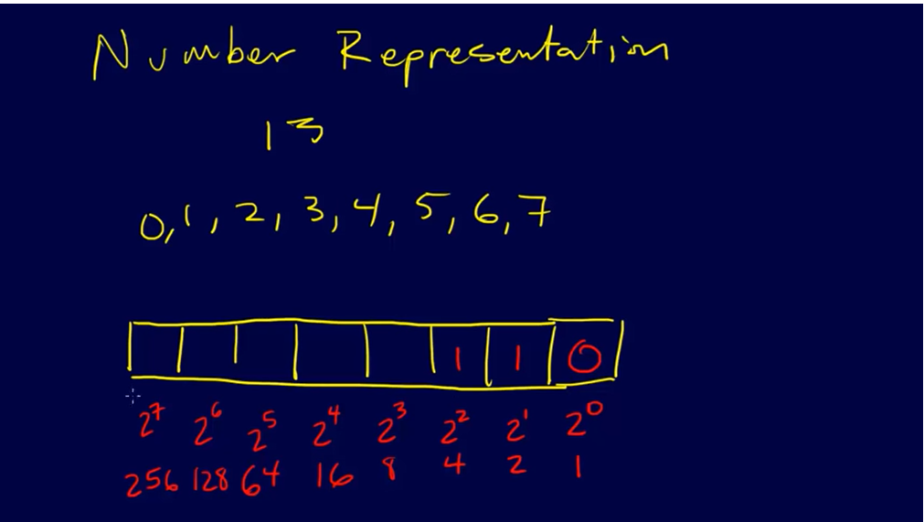

Slide 30
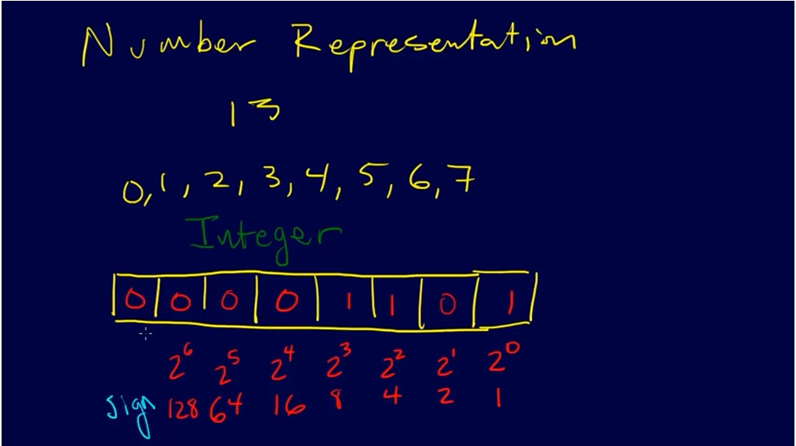

Slide 31
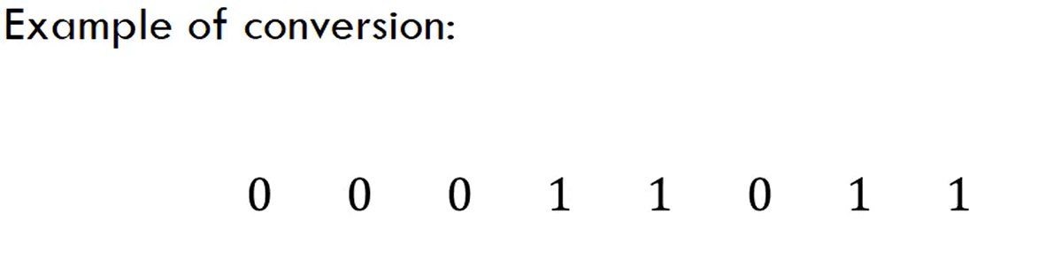

Slide 32
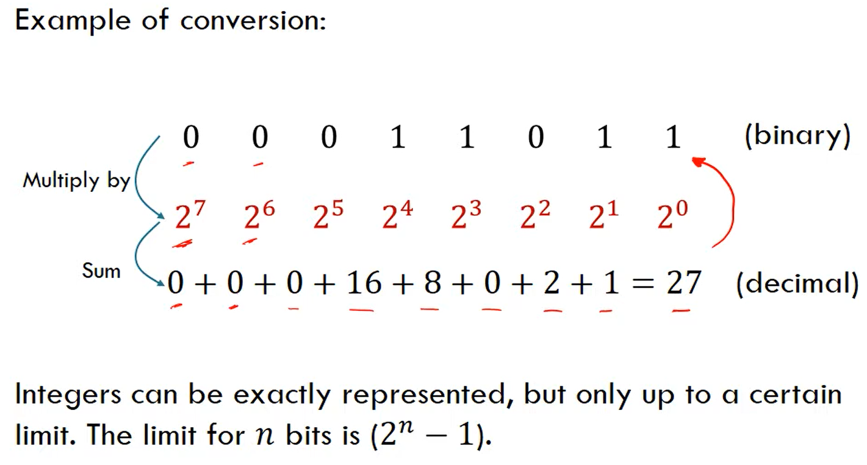

Slide 33
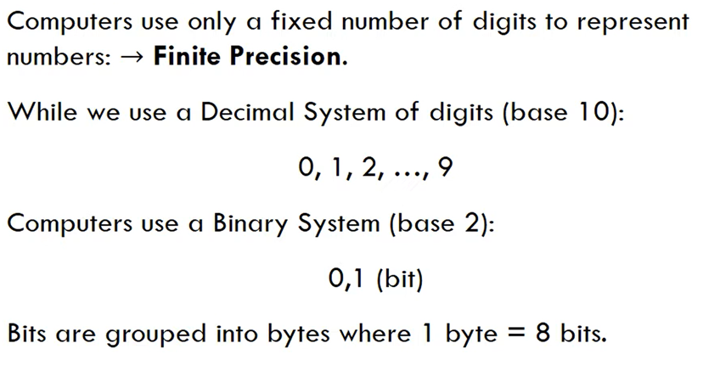
Floating Point Numbers

Slide 34
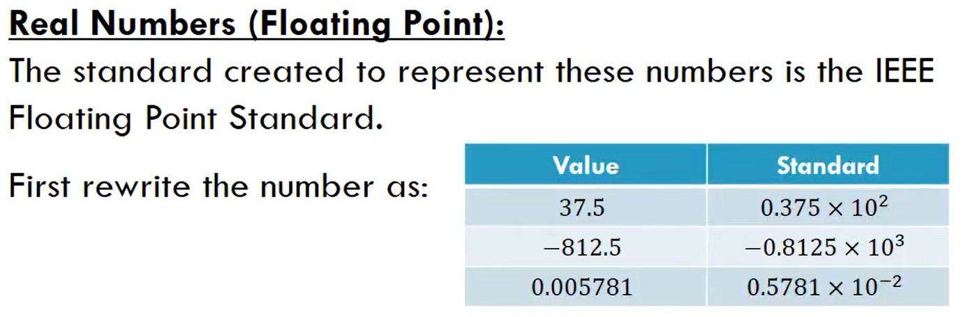

Slide 35
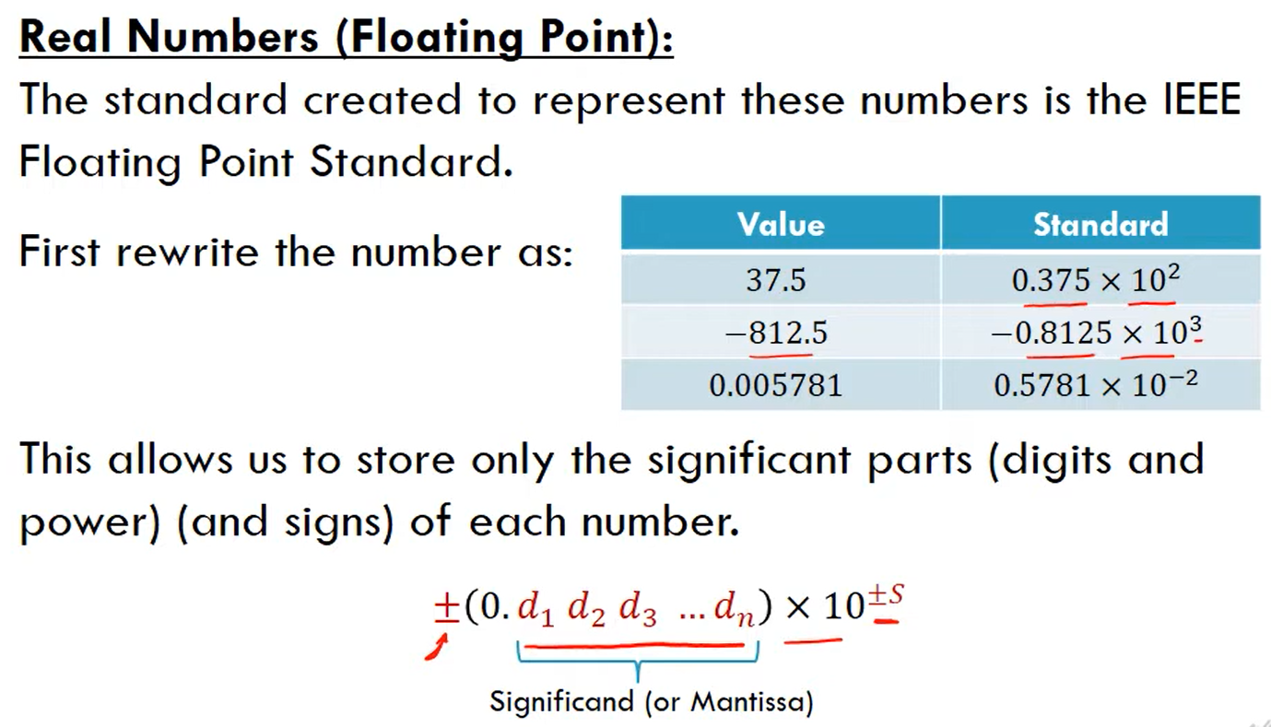

Slide 36
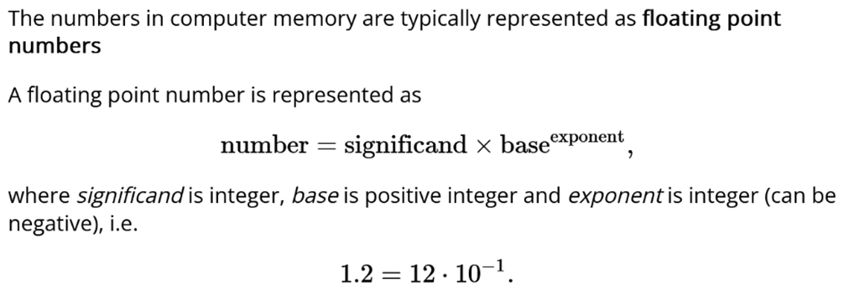
Floating Point Numbers

Slide 37
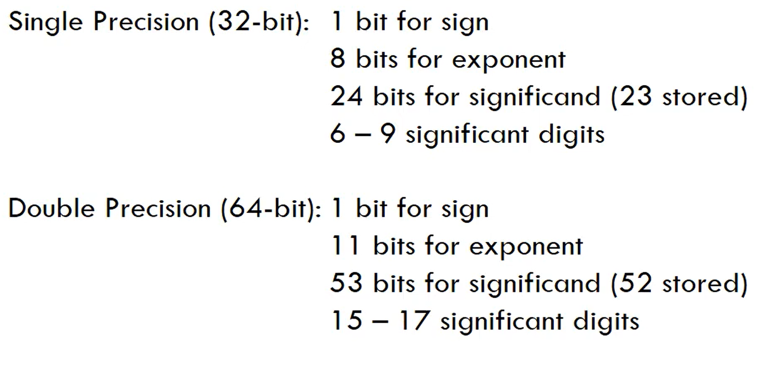

Slide 38
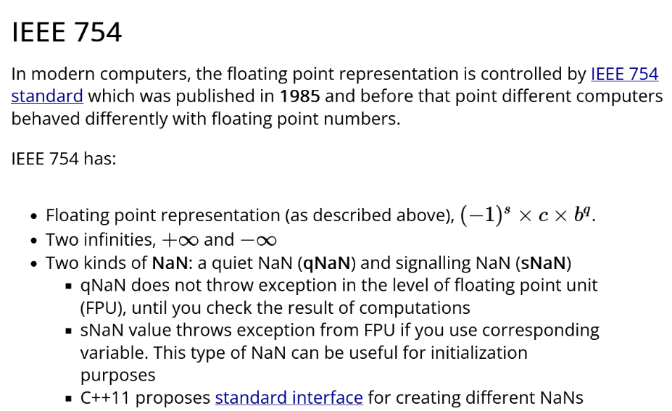

Slide 39
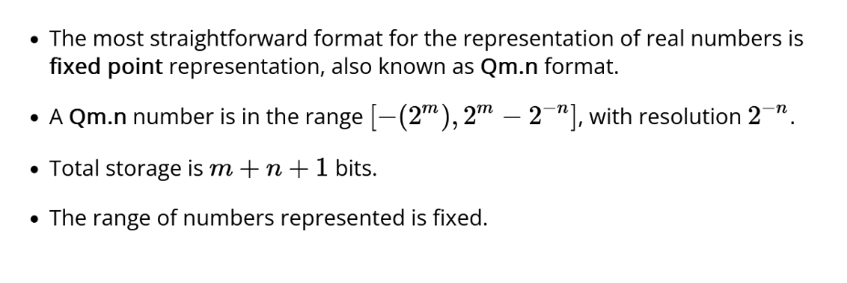
Fixed Point
In computing, fixed-point is a method of representing fractional (non-integer) numbers by storing a fixed number of digits of their fractional part
Notes:
Q notation

Slide 40
Fixed Point
For example, the specification Q3.12 describes a signed binary fixed-point number with a w = 16 bits in total, comprising the sign bit, three bits for the integer part, and 12 bits that are the fraction
Limited range : Precision is only 8 and 16
Uses integers but changes their meaning
Multiplies the integer by a scaling factor
Eg. In an integer 6 will become 0.6 because we multiply by a scaling factor of 1/10
And 28 becomes 2.8.

Slide 41
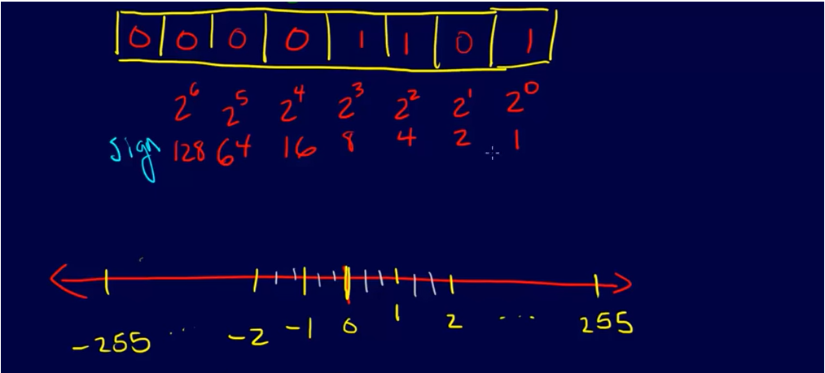
Fixed Point
Notes:
So we add more numbers in between to increase the values
Flexibility in precision 8 bits or 16 bots
Range is less than floating point
Coding is confusing

Slide 42
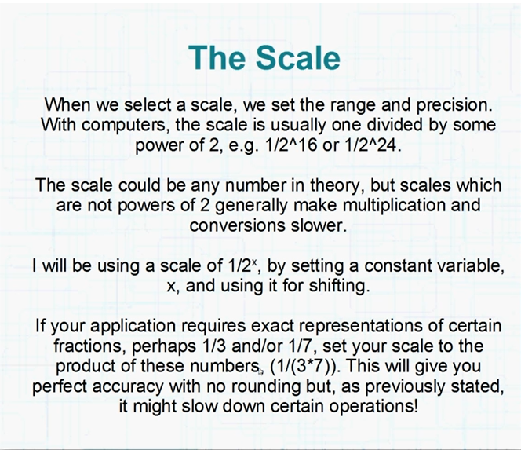

Slide 43
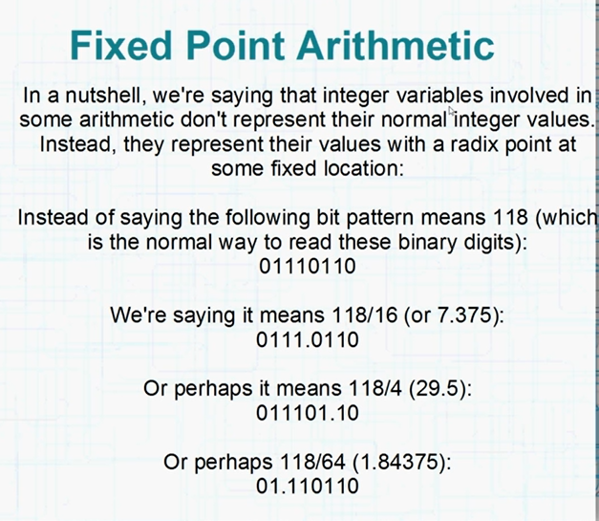

Slide 44
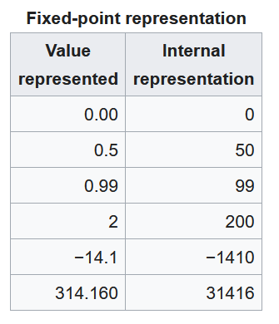

Slide 45
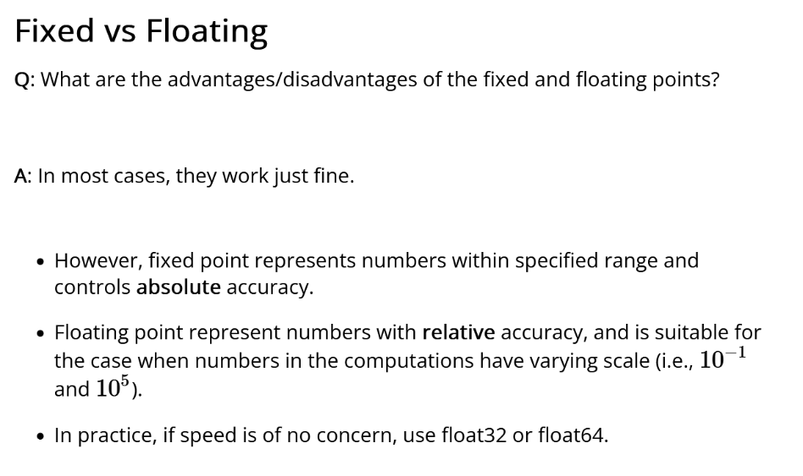
Notes:
With floating point the value of the number can change but with fixed point if you choose a particular scaling factor the value is fixed

Slide 46
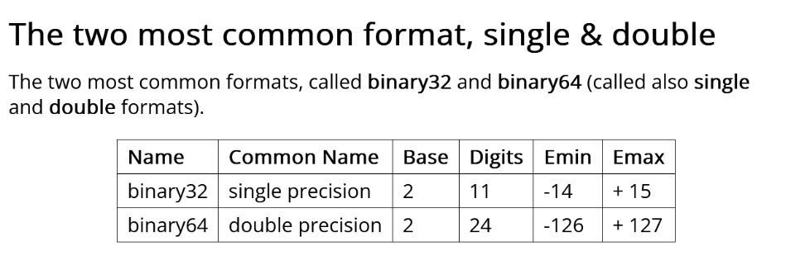

Slide 47
Measuring Errors
Why measure errors?
1) To determine the accuracy of numerical results.
2) To develop stopping criteria for iterative algorithms.

Slide 48
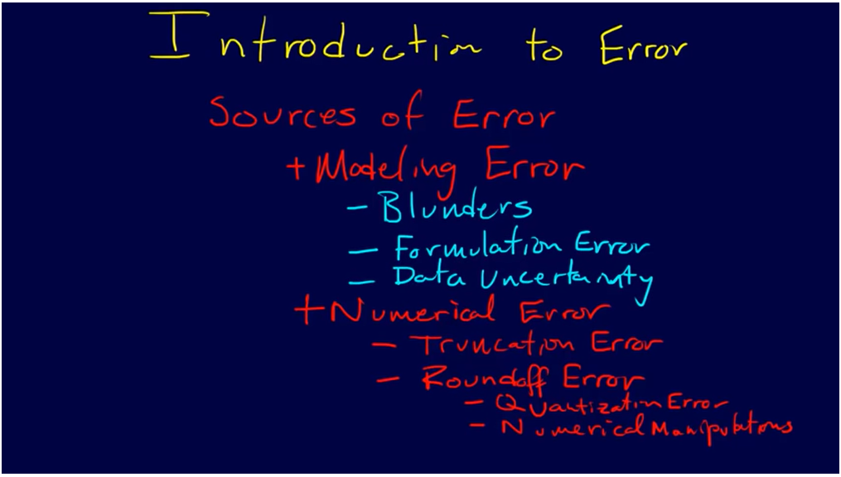

Slide 49
True Error
Defined as the difference between the true value in a calculation and the approximate value found using a numerical method etc.
True Error = True Value – Approximate Value

Slide 50
Approximate Error
What can be done if true values are not known or are very difficult to obtain?
Approximate error is defined as the difference between the present approximation and the previous approximation.
Approximate Error (
) = Present Approximation – Previous Approximation

Slide 51
Relative True Error
Defined as the ratio between the true error, and the true value.
True Error
Relative True Error (
) =
True Value

Slide 52
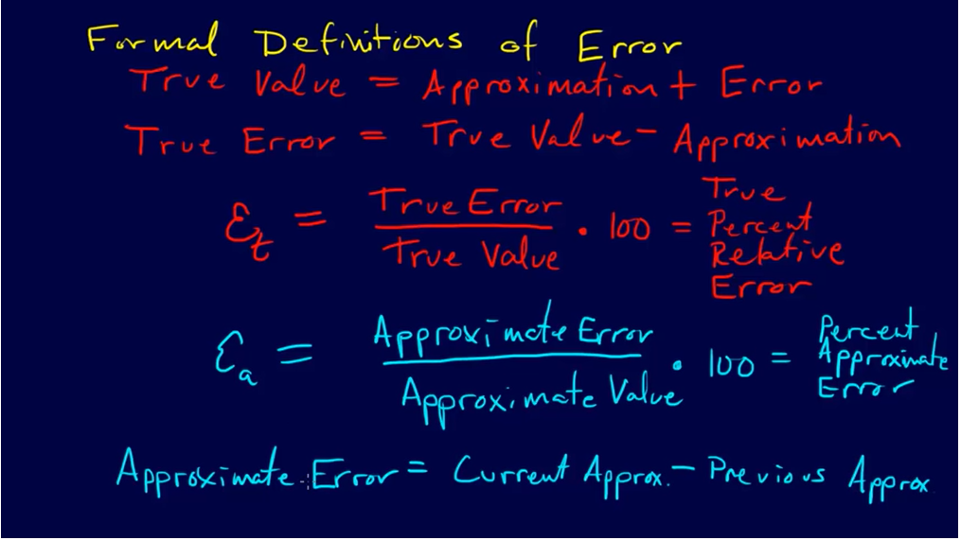
Definition of Error
Relative True Error =ϵ_{t}
Relative approximate Error=ϵ_{t}
Notes:
Appriximate error=we do this because
We seldom know what the true value is that why we use an approximate error.
Note: we are talking about true value according to our mathematical modelling,
So our definitions are talking about numerical error – lends itself to numerical analysis
Only quantifying numerical errors.

Slide 53
Example—True Error
The derivative,
of a function
can be
approximated by the equation,
If
and
a) Find the approximate value of
b) True value of
c) True error for part (a)

Slide 54
Example (cont.)
Solution:
a) For
and

Slide 55
Example (cont.)
Solution:
b) The exact value of
can be found by using
our knowledge of differential calculus.
So, the true value of
is
True error is calculated as
True Value – Approximate Value

Slide 56
Example—Relative True Error
Following from the previous example for true error,
find the relative true error for
at
with
From the previous example,
Relative True Error is defined as
as a percentage,

Slide 57
Example—Approximate Error
For
at
find the following,
a)
using
b)
using
c) approximate error for the value of
for part b)
Solution:
a) For
and

Slide 58
Example (cont.)
Solution: (cont.)
b) For
and

Slide 59
Example (cont.)
Solution: (cont.)
c) So the approximate error,
is
Present Approximation – Previous Approximation

Slide 60
Relative Approximate Error
Defined as the ratio between the approximate error and the present approximation.
Approximate Error
Relative Approximate Error (
) =
Present Approximation

Slide 61
Example—Relative Approximate Error
For
at
, find the relative approximate
error using values from
and
Solution:
From Example 3, the approximate value of
using
and
using
Present Approximation – Previous Approximation

Slide 62
Example (cont.)
Solution: (cont.)
Approximate Error
Present Approximation
as a percentage,
Absolute relative approximate errors may also need to be calculated,

Slide 63
How is Absolute Relative Error used as a stopping criterion?
If
where
is a pre-specified tolerance, then
no further iterations are necessary and the process is stopped.
If at least m significant digits are required to be correct in the final answer, then

Slide 64
Table of Values
For
at
with varying step size,
0.3 | 10.263 | N/A | 0
0.15 | 9.8800 | 3.877% | 1
0.10 | 9.7558 | 1.273% | 1
0.01 | 9.5378 | 2.285% | 1
0.001 | 9.5164 | 0.2249% | 2
Notes:
The concept of convergence.

Slide 65
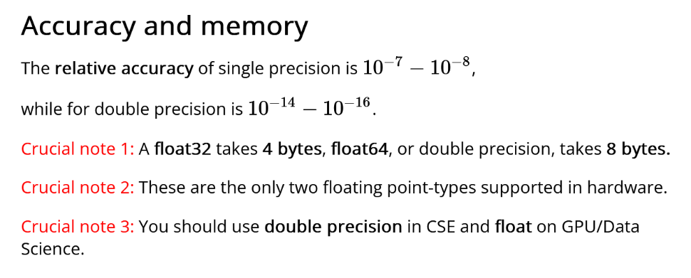

Slide 66
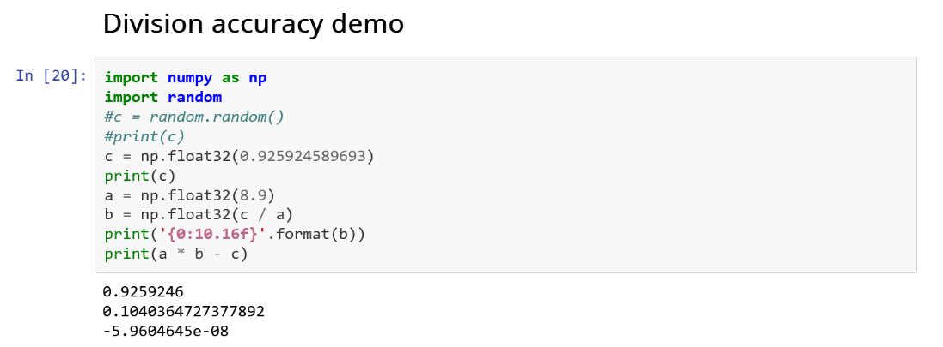

Slide 67
Error modelling : Iterative method
Compare direct method to iterative method.
Eg finding the roots of an equation?

Slide 68
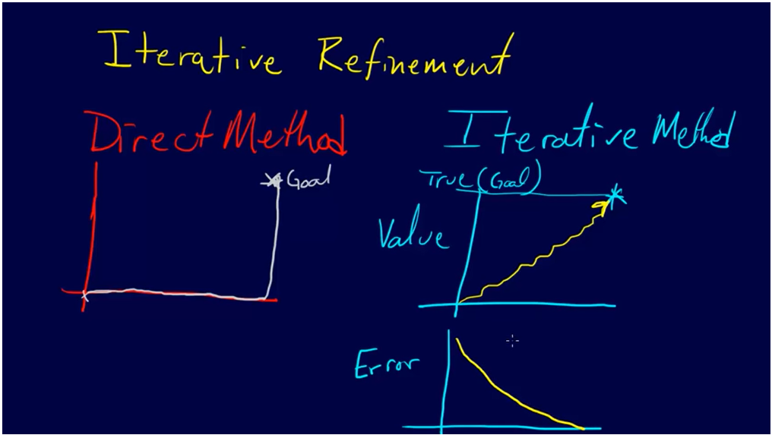
Error modelling : Iterative method

Slide 69
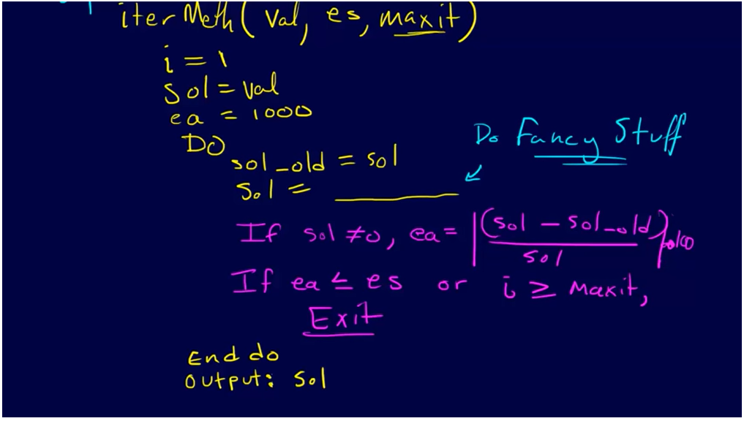
Error modelling : Iterative method

Slide 70
Recap from last week
Examples of real world applications that involve computation
Trade off in Numerical analysis
Notes:
Examples of real world applications that involve computation

Slide 71
Representation error: Round off error and truncation error
Errors inherent in numerical analysis
The floating point numbers are represented in computers as base 2 fractions. This has a side effect that the floating point numbers can not be stored with perfect precision, instead the numbers are approximated by finite number of bytes.
Therefore, the difference between an approximation of a number used in computation and its correct (true) value is called round-off error.
It is one of the common errors usually in the numerical calculations.
Egs??
The other one is truncation error
Notes:
Errors inherent in numerical analysis

Slide 72
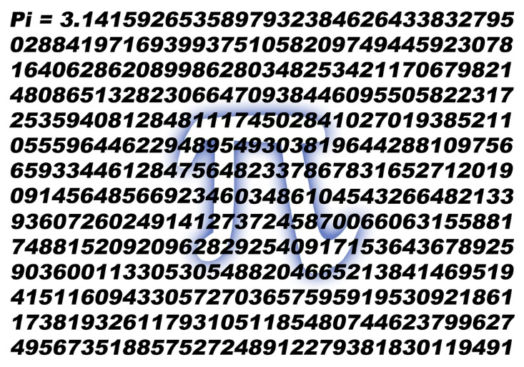
Round off error
Round off caused by approximating numbers
The most common form round-off error is the representation error in the floating point numbers.
A simple example will be to represent π.
We know that π is an infinite number, but when we use it, we usually only use a finite digits.
For example, if you only use 3.14159265, there will be an error between this approximation and the true infinite number.
Consider two things: are we Chopping or we are Rounding?
However, the error caused by either chopping or rounding is still called round off error

Slide 73
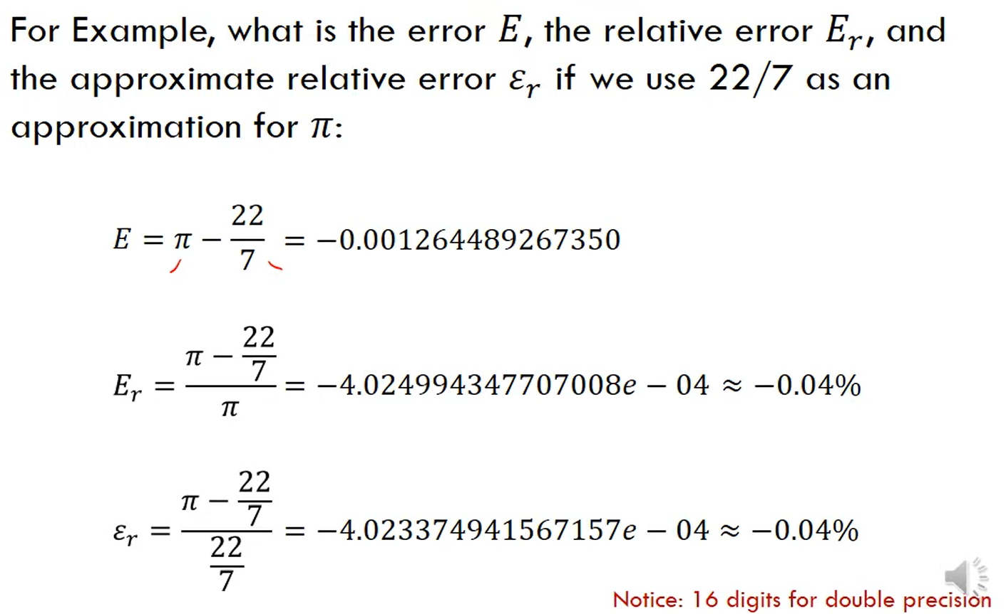

Slide 74
Round off error
Round off error = Actual number – Representation of number
Another example will be 1/3, the true value will be 0.333333…,
no matter how many decimal digits we choose, there is an round-off error as well.
Round off error= 1/3 – 0.333333
= 0.00000033333
Also, when we round the numbers multiple times, the error will accumulate.
For instance, if 4.845 is rounded to two decimal places, it is 4.85. Then if we round it again to one decimal place, it is 4.9, the total error will be 0.55. But if we only round one time to one decimal place, it is 4.8, which the error is 0.045.

Slide 75
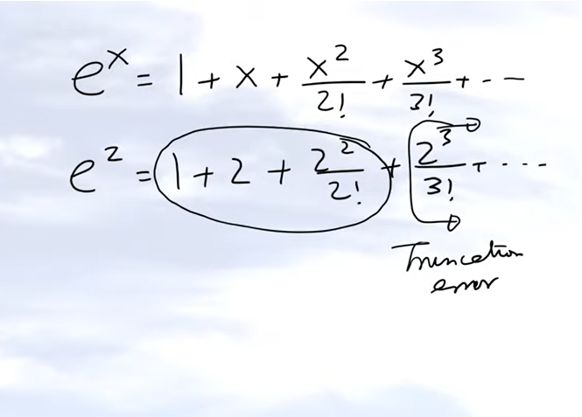
Truncation Error
Caused by approximating mathematical processes
Truncation error = True Value – Approximate Value (of a mathematical process)
So you have infinite number of terms in this particular series for e to the power x.
The Maclaurin series for e to the power x
Notes:
It is, truncation error is related to the error which is created by approximating, not numbers, but a mathematical procedure.

Slide 76


Truncation Error
Integrate from a to b
Notes:
integr

Slide 77


Truncation Error
differential calculus, you already know that the derivative of a function

Slide 79

Convex function

Slide 80

Convex and Concave function

Slide 81


Concept of Convergence
When your tolerance (true value) and approximated error is approaching zero

Slide 82
Week 2: Talk Outline
Scalars, vectors and matrices
Vector and matrix calculations
Identity, inverse matrices & determinants
Linear Algebra & Matrices, MfD 2009

Slide 83


Slide 84














Lots of real world data is a multi-dimensional array
Color images, videos, MRI, EEG data can be categorized as Matrices and tensors
Examples of such data
Multi-channels Spectrogram (3rd order)
Multi-channel signals (EEG etc)
=
RGB/Color image (3rd Order)
・・・
Multiple MRI (4th order)
84

Slide 85



Voxel-wise time series analysis
Model
specification
Parameter
estimation
Time
Hypothesis
Statistic
Time
BOLD signal
single voxel
time series
SPM
Linear Algebra & Matrices, MfD 2009
Notes:
Show an example

Slide 86

Scalar
Variable described by a single number
e.g. Intensity of each voxel in an MRI scan
Linear Algebra & Matrices, MfD 2009

Slide 87
Vector
Not a physics vector (magnitude, direction)
Column of numbers e.g. intensity of same voxel at different time points

Slide 88



Scalars, vectors and matrices
Scalar: Variable described by a single number – e.g. Image intensity (pixel value)
Vector: Variable described by magnitude and direction
Matrix: Rectangular array of scalars
2
3
Square (3 x 3) Rectangular (3 x 2) d _{r c} : r^{th} row, c^{th} column

Slide 89
Transposition
column row row column
Linear Algebra & Matrices, MfD 2009

Slide 90
Transposition
column → row row → column
M_{rc} = M_{cr}

Slide 91


Slide 92
Matrices
Rectangular display of vectors in rows and columns
Can inform about the same vector intensity at different times
Vector is just a n x 1 matrix
Square (3 x 3) Rectangular (3 x 2) d _{i j} : i^{th} row, j^{th} column
Defined as rows x columns (R x C)
Linear Algebra & Matrices, MfD 2009

Slide 93
Matrices
A matrix is defined by the number of Rows and the number of Columns.
An mxn matrix has m rows and n columns.
A = 4x3 matrix
A square matrix of order n, is an nxn matrix.
Matlab notes ( ; → End of matrix row )
A = [ 21 5 53 ; 5 34 12 ; 6 33 55 ; 74 27 3 ]
To extract data: Matrix name( row, column )
Scalar Data Point A( 1 , 2 ) = 2
Row Vector A( 2 , : ) = [ 5 34 12 ]
Column Vector A( : , 3 ) = [ 53 ; 12 ; 55 ; 3 ]
Smaller Matrix A(2:4,1:2) = [ 5 34 ; 6 33 ; 74 27 ]
Another Matrix A( 2:2:4 , 2:3 ) = [ 34 12 ; 27 3 ]
21 | 2 | 53
5 | 34 | 12
6 | 33 | 55
74 | 27 | 3

Slide 94
Matrices in Matlab
X=matrix
;=end of a row
:=all row or column
Subscripting – each element of a matrix can be addressed with a pair of numbers; row first, column second (Roman Catholic)
e.g. X(2,3) = 6
X(3, :) =
X( [2 3], 2) =
“Special” matrix commands:
zeros(3,1) =
ones(2) =
magic(3) =

Slide 95
Matrix Calculations
Addition
Commutative: A+B=B+A
Associative: (A+B)+C=A+(B+C)
Subtraction
- By adding a negative matrix

Slide 96

Scalar multiplication
Scalar x matrix = scalar multiplication

Slide 97
Matrix multiplication
Matrix multiplication is NOT commutative
AB≠BA
Matrix multiplication IS associative
A(BC)=(AB)C
Matrix multiplication IS distributive
A(B+C)=AB+AC
(A+B)C=AC+BC
Linear Algebra & Matrices, MfD 2009

Slide 98
Matrix Multiplication
“When A is a mxn matrix & B is a kxl matrix, AB is only possible if n=k. The result will be an mxl matrix”
n
l
A₁ A₂ A₃
A₄ A₅ A₆
A₇ A₈ A₉
A₁₀ A₁₁ A₁₂
B₁₃ B₁₄
B₁₅ B₁₆
B₁₇ B₁₈
m
x
k
= m x l matrix
Number of columns in A = Number of rows in B

Slide 99



Matrix multiplication
Constant (or Scalar)
multiplication of a matrix:
Matrix multiplication rule:
When A is a mxn matrix & B is a kxl matrix, the multiplication of AB is only viable if n=k. The result will be an mxl matrix.

Slide 100
Matrix multiplication
Multiplication method:
Sum over product of respective rows and columns
X
=
Define output matrix
A
B
=
Matlab does all this for you!
Simply type: C = A * B
=
Linear Algebra & Matrices, MfD 2009

Slide 101
Matrix addition
Addition (matrix of same size)
Commutative: A+B=B+A
Associative: (A+B)+C=A+(B+C)
Subtraction consider as the addition of a negative matrix

Slide 102
Vector Products
Two vectors:
Inner product X^{T}Y is a scalar
(1xn) (nx1)
Inner product = scalar
Outer product = matrix
Outer product XY^{T} is a matrix
(nx1) (1xn)
Linear Algebra & Matrices, MfD 2009

Slide 103
Example
Two vectors:
Inner product = scalar
Note: (1xn)(nx1) → (1X1)
Outer product = matrix
Note: (nx1)(1xn) → (nXn)

Slide 104
Visualising multiplying
A matrix = ( m x n )
B matrix = ( k x l )
A x B is only viable if
k = n
width of A = height of B
Result Matrix = ( m x l )
a₁₁ | a₁₂ | a₁₃ |  | b₁₁ | b₁₂ |  | ? | ?
a₂₁ | a₂₂ | a₂₃ | X | b₂₁ | b₂₂ | = | ? | ?
a₃₁ | a₃₂ | a₃₃ |  | b₃₁ | b₃₂ |  | ? | ?
a₄₁ | a₄₂ | a₄₃ |  |  |  |  | ? | ?
 |  |  |  |  |  | b₁₁ |  |  |  |  |  | b₁₂
 |  |  |  |  |  | b₂₁ |  |  |  |  |  | b₂₂
 |  |  |  |  |  | b₃₁ |  |  |  |  |  | b₃₂
a₁₁ | a₁₂ | a₁₃ |  | a₁₁b₁₁ | + | a₁₂b₂₁ | + | a₁₃b₃₁ |  | a₁₁b₁₂ | + | a₁₂b₂₂ | + | a₁₃b₃₂
a₂₁ | a₂₂ | a₂₃ |  | a₂₁b₁₁ | + | a₂₂b₂₁ | + | a₂₃b₃₁ |  | a₂₁b₁₂ | + | a₂₂b₂₂ | + | a₂₃b₃₂
a₃₁ | a₃₂ | a₃₃ |  | a₃₁b₁₁ | + | a₃₂b₂₁ | + | a₃₃b₃₁ |  | a₃₁b₁₂ | + | a₃₂b₂₂ | + | a₃₃b₃₂
a₄₁ | a₄₂ | a₄₃ |  | a₄₁b₁₁ | + | a₄₂b₂₁ | + | a₄₃b₃₁ |  | a₄₁b₁₂ | + | a₄₂b₂₂ | + | a₄₃b₃₂

Slide 105


Slide 106


Slide 107

Identity matrix
Is there a matrix which plays a similar role as the number 1 in number multiplication?
Consider the nxn matrix:
For any nxn matrix A, we have A I_{n} = I_{n} A = A
For any nxm matrix A, we have I_{n} A = A, and A I_{m} = A (so 2 possible matrices)

Slide 108
Identity matrix
Worked example
A I₃ = A
for a 3x3 matrix:
1 | 2 | 3 |  | 1 | 0 | 0 |  | 1+0+0 | 0+2+0 | 0+0+3
4 | 5 | 6 | X | 0 | 1 | 0 | = | 4+0+0 | 0+5+0 | 0+0+6
7 | 8 | 9 |  | 0 | 0 | 1 |  | 7+0+0 | 0+8+0 | 0+0+9
In Matlab: eye(r, c) produces an r x c identity matrix
Linear Algebra & Matrices, MfD 2009

Slide 109
Identity matrices
Is there a matrix which plays a similar role as the number 1 in number multiplication?
Consider the nxn matrix:
A square nxn matrix A has one
A I_{n} = I_{n} A = A
An nxm matrix A has two!!
I_{n} A = A & A I_{m} = A
Worked example
A In = A
for a 3x3 matrix:
1 | 2 | 3 |  | 1 | 0 | 0 |  | 1+0+0 | 0+2+0 | 0+0+3
4 | 5 | 6 | X | 0 | 1 | 0 | = | 4+0+0 | 0+5+0 | 0+0+6
7 | 8 | 9 |  | 0 | 0 | 1 |  | 7+0+0 | 0+8+0 | 0+0+9

Slide 110


Slide 111
Matrix inverse
Definition. A matrix A is called nonsingular or invertible if there exists a matrix B such that:
1 | 1 | X | 2 3 | -1 3 | = | 2 + 1 3 3 | -1 + 1 3 3 | = | 1 | 0
-1 | 2 |  | 1 3 | 1 3 |  | -2+ 2 3 3 | 1 + 2 3 3 |  | 0 | 1
Notation. A common notation for the inverse of a matrix A is A⁻¹. So:
The inverse matrix is unique when it exists. So if A is invertible, then A⁻¹ is also invertible and then (A^{T})⁻¹ = (A⁻¹)^{T}
In Matlab: A⁻¹ = inv(A)
Matrix division: A/B= A*B⁻¹
Linear Algebra & Matrices, MfD 2009

Slide 112

Inverse matrices
Definition. A matrix A is nonsingular or invertible if there exists a matrix B such that: worked example:
1 | 1 | X | 2 3 | -1 3 | = | 2 + 1 3 3 | -1 + 1 3 3 | = | 1 | 0
-1 | 2 |  | 1 3 | 1 3 |  | -2+ 2 3 3 | 1 + 2 3 3 |  | 0 | 1
Notation. A common notation for the inverse of a matrix A is A⁻¹.
The inverse matrix A⁻¹ is unique when it exists.
If A is invertible, A⁻¹ is also invertible → A is the inverse matrix of A⁻¹.
If A is an invertible matrix, then (A^{T})⁻¹ = (A⁻¹)^{T}

Slide 113



Matrix inverse
For a nxn square matrix:
The inverse matrix is:
E.g.: 2x2 matrix

Slide 114
Matrix Inverse - Calculations
i.e.
Note: det(A)≠0
A general matrix can be inverted using methods such as the Gauss-Jordan elimination, Gaussian elimination or LU decomposition

Slide 115
Determinants
Determinants are mathematical objects that are very useful in the analysis and solution of systems of linear equations
The determinant is a function that associates a scalar det(A) to every square matrix A.
Input is nxn matrix
Output is a single number (real or complex) called the determinant
Linear Algebra & Matrices, MfD 2009

Slide 116

Determinants
Determinants can only be found for square matrices.
For a 2x2 matrix A, det(A) = ad-bc. Lets have at closer look at that:
[ ]
det(A) =
a b
c d
= ad - bc
In Matlab: det(A) = det(A)
A matrix A has an inverse matrix A⁻¹ if and only if det(A)≠0.

Slide 117
Determinants
Determinant is a function:
Input is nxn matrix
Output is a real or a complex number called the determinant
In MATLAB
use the command det(A)" to compute the determinant of a given square matrix A
A matrix A has an inverse matrix A-1 if and only if det(A)≠0.
-
-
-
+
+
+

Slide 118
Solving simultaneous equations using inverse matrices
For one linear equation ax=b where the unknown is x and a and b are constants,
3 possibilities:
Linear Algebra & Matrices, MfD 2009

Slide 119
With >1 equation and >1 unknown
Can use solution from the single equation to solve
For example
In matrix form
A X = B
X =A⁻¹B
Linear Algebra & Matrices, MfD 2009

Slide 120
X =A⁻¹B
To find A⁻¹
Need to find determinant of matrix A
From earlier
(2 x-2) – (3x 1) = -4 – 3 = -7
So determinant is -7

Slide 121
if B is
So

Slide 122
How are matrices relevant to data? Which areas in computing and programming do we use matrices?
Notes:
Which areas in data science do we use matr

Slide 123
Some Application Areas

Slide 124
Some Application Areas
Simultaneous Equations
Simple Neural Network
Generalised Linear Model (GLM)

Slide 125
System of linear equations
Resolving simultaneous equations can be applied using Matrices:
➔
Multiply a row by a non-zero constant
Interchange two rows
Add a multiple of one row to another row
Also known as
Gauss-Jordan Elimination
…

